Slide 1
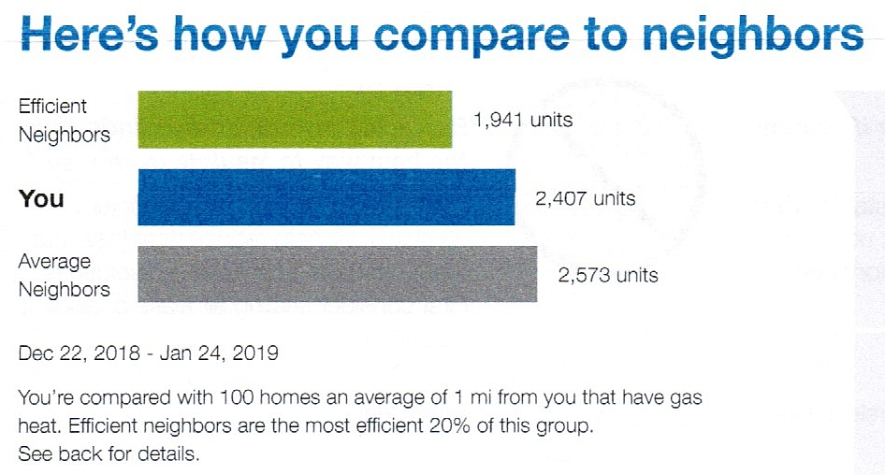
Utility Bills
Everyday Data Viz
Finance
Sources: National Grid (2019). Jamison’s Energy Bill. NASDAQ Market Summary (2019). Activision Blizzard.

Slide 2
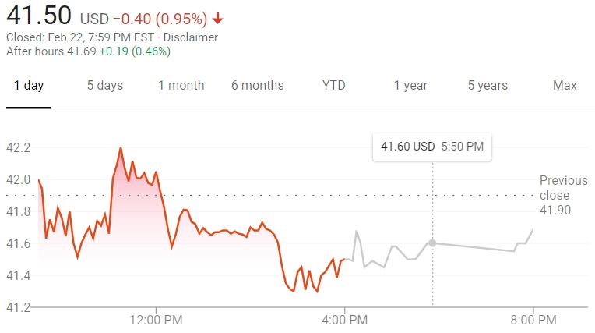
Utility Bills
Everyday Data Viz
Finance
Sources: National Grid (2019). Jamison’s Energy Bill. NASDAQ Market Summary (2019). Activision Blizzard.

Slide 3
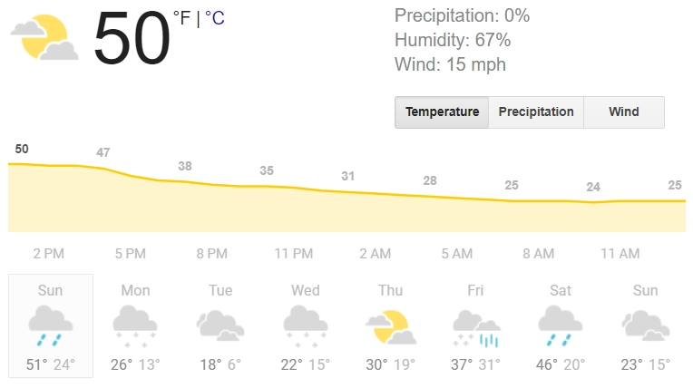
Gaming
Everyday Data Viz
Weather
Sources: Steam (2012). Individual Achievement Progress, Portal. Weather.com (2019). Weather for Syracuse, NY, 2019-02-24.

Slide 4
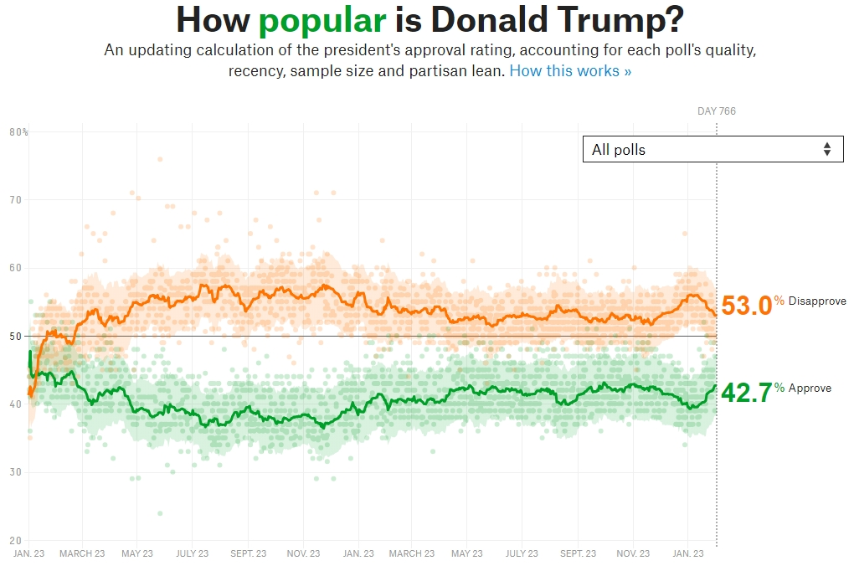
Wearable Tech
Everyday Data Viz
Politics
Sources: Fitbit App (2019). Sleeping Patterns. FiveThirtyEight (2019). How Popular is Donald Trump?

Slide 5
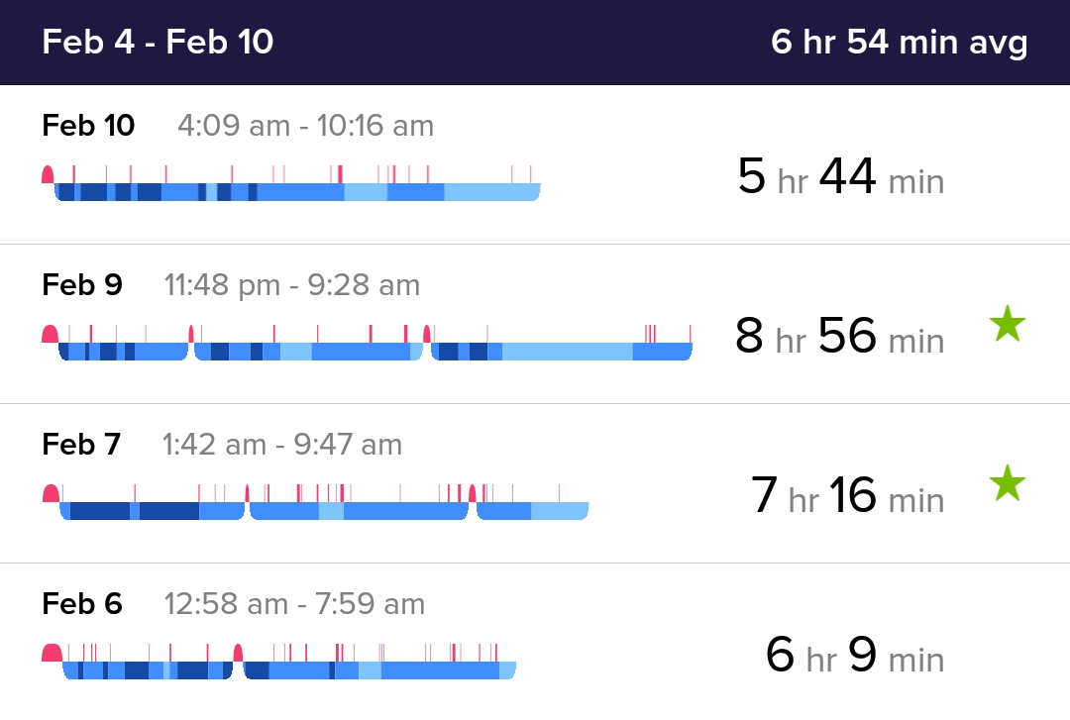
Wearable Tech
Everyday Data Viz
Politics
Sources: Fitbit App (2019). Sleeping Patterns. FiveThirtyEight (2019). How Popular is Donald Trump?

Slide 6
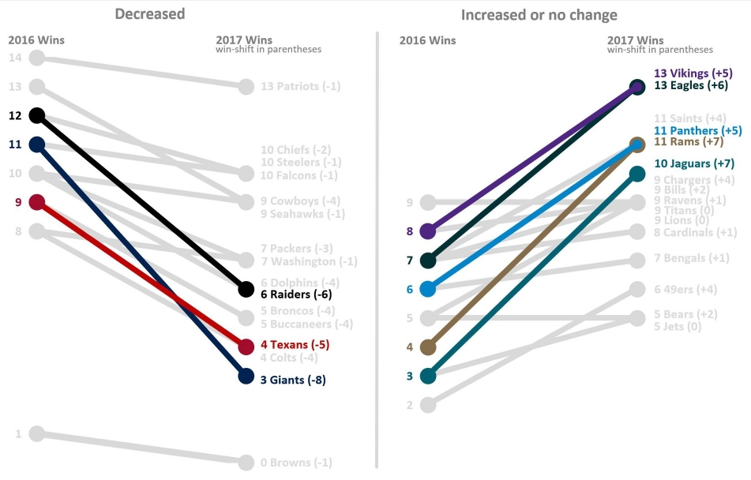
Sports
Everyday Data Viz
Travel
Sources: Pauley, Jason (2018). Shifting NFL Team W/L Records – Visualized. Google Maps (2019). Routes from Buffalo, NY to Syracuse, NY.

Slide 7
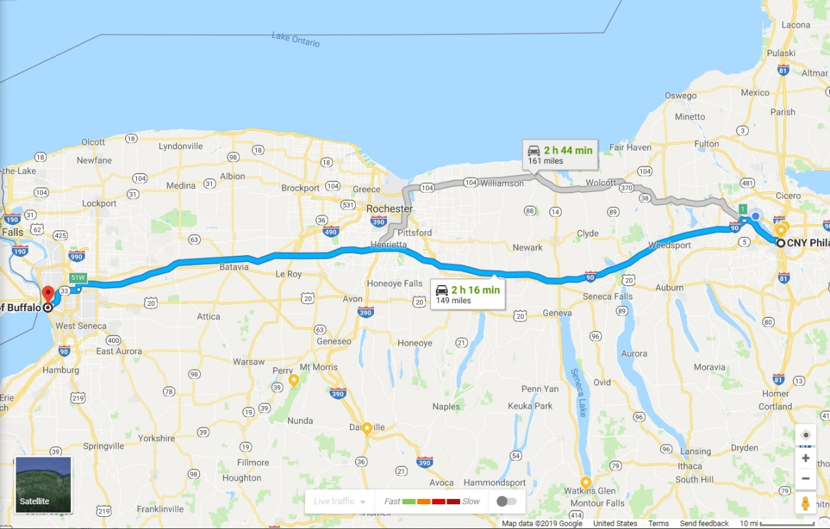
Sports
Everyday Data Viz
Travel
Sources: Pauley, Jason (2018). Shifting NFL Team W/L Records – Visualized. Google Maps (2019). Routes from Buffalo, NY to Syracuse, NY.

Slide 8
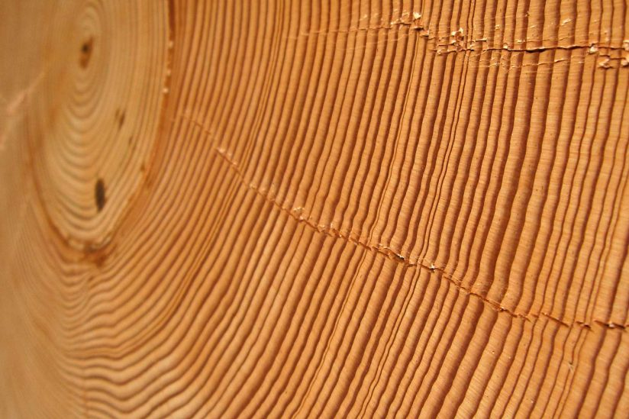
Sources: Gersema, Emily (2017). Scientists have more data to back their findings: The Earth is getting warmer. Geggel, Laura (2018). That Sea Stack from Reddit Didn’t take ‘Millions of Years’ to Form.

Slide 9
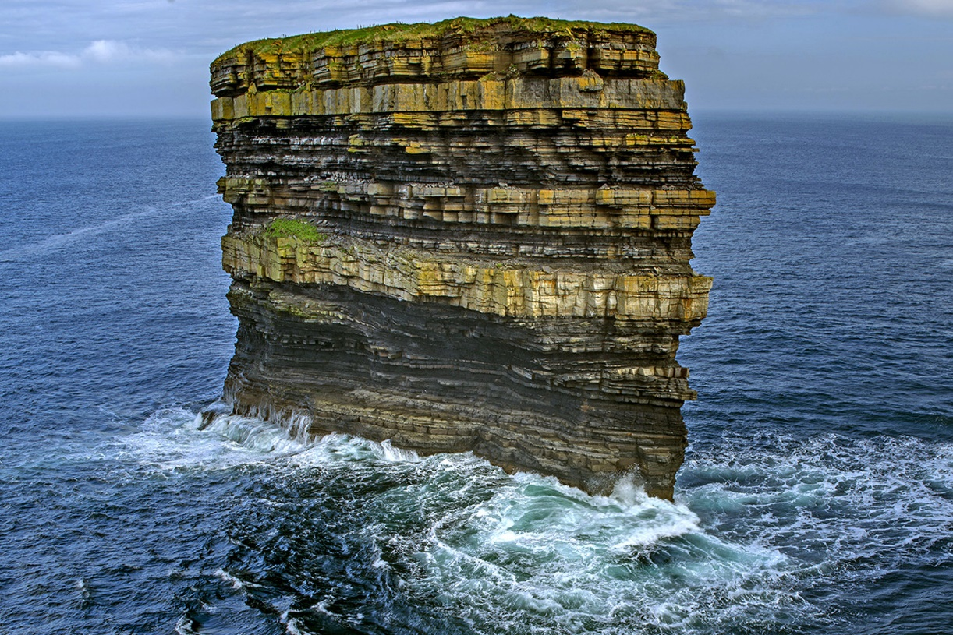
Sources: Gersema, Emily (2017). Scientists have more data to back their findings: The Earth is getting warmer. Geggel, Laura (2018). That Sea Stack from Reddit Didn’t take ‘Millions of Years’ to Form.

